Slide 1
Object-Oriented Design
Lecturer: Ngo Huy Bien
Software Engineering Department
Faculty of Information Technology
VNUHCM - University of Science
Ho Chi Minh City, Vietnam
nhbien@fit.hcmus.edu.vn

Slide 2

Objectives
To design software systematically.

Slide 3

Contents
OO Design Methodology.
Designing with Patterns.
Design and Programming Relationship.

Slide 4

References
Ralph E. Johnson and Brian Foote (1988). Designing Reusable Classes.
Grady Booch et al. (2005). The Unified Modeling Language User Guide. Addison Wesley Professional.
Rebecca Wirfs-Brock and Brian Wilkerson (1989). Object-Oriented Design: A Responsibility-Driven Approach.
David Budgen (2003). Software Design. Pearson.
Robert C. Martin (2017). Clean Architecture - A Craftsman's Guide to Software Structure and Design. Pearson Education.

Slide 5

Key Ideas
Notations
Steps
Templates

Slide 6

Steps
Create Use Case diagram.
Create UI design.
Create Class diagram and Database design.
Dump some data to database Tables or Objects.
Create Save method for some classes.
Create System Sequence diagram.
Create Sequence diagram.
Create Flow Chart, State diagram.

Slide 7
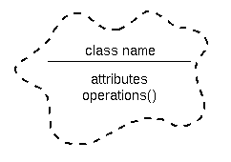
OO Design Methodology [1]
Object-oriented design starts with objects.
The designer start with a natural language description of the desired system and use the nouns as a starting point for the classes of objects to be designed.
Each verb is an operation, either one implemented by a class (when the class is the direct object) or one used by the class (when the class is the subject).
The resulting list of classes and operations can be used as the start of the design process.

Slide 8

Booch's OO Design Methodology [2]
Identification of Classes (and Objects)
Key abstractions in the problem space are identified and labeled as potential classes and objects.
Identify the Semantics of Classes (and Objects)
The meaning of the classes and objects identified in the previous step is established, this includes definition of the life-cycles of each object from creation to destruction.
Identify Relationships Between Classes (and Objects)
Class and object interactions, such as patterns of inheritance among classes and patterns of visibility among objects and classes are identified
Implementation of Classes (and Objects)
Detailed internal views are constructed, including definitions of methods and their various behaviors

Slide 9
Abstract Data Type Design [3]
An abstract data type is the encapsulation of data and the algorithms that operate on that data.
Abstract data types are designed by asking the questions:
What data does this type subsume?
and
What algorithms can be applied to this data?
This can be done initially by identifying the data required by the program (perhaps only a portion of it). This data can then be grouped into types using cohesion as a guide.
Finally, identifying the algorithms associated with those types of data often leads to the discovery of other types that are required.

Slide 10
Data-Driven Design
Data-driven design is the result of adapting abstract data type design methods to object-oriented programming.
In a data-driven design, objects are designed by asking the questions:
What (structure) does this object represent?
and
What operations can be performed by this object?

Slide 11
The Strength of Data-Driven Design
The main benefit of the data-driven approach is that it is a familiar process for programmers experienced with traditional procedural languages.
It is relatively easy for such programmers to adapt their previous experience to the design of object-oriented systems.

Slide 12
The Weakness of Data-Driven Design
Even though the goal of data-driven design is to encapsulate data and algorithms, it inherently violates that encapsulation by making the structure of an object part of the definition of the object.
This in turn leads to the definition of operations that reflect that structure (because they were designed with the structure in mind).
Attempts to change the structure of an object transparently are destined to fail because other classes rely on that structure. This is the antithesis of encapsulation.

Slide 13
The Client/Server Model
The client/server model is a description of the interaction between two entities: the client and the server.
A client makes requests of the server to perform services.
A Server provides a set of services upon request.
The ways in which the client can interact with the server are described by a contract: a list of the requests that can be made of the server by the client.
Both must fulfill the contract: the client by making only those requests it specifies and the server by responding to those requests.
The advantage of the client/server model is that it focuses on what the server does for the client, rather than how the server does it.

Slide 14
Type of Clients
A class may have three distinct type of clients:
External Clients: The set of messages that an object responds to, including the types of arguments and the return type, defines the contract between the client and the server.
Subclass Clients: In most object-oriented languages, subclasses inherit not only the behavior but also the structure defined by their super-classes. This is unfortunate, as it tends to encourage programmers to violate encapsulation in order to increase the amount of code reused.
Self Client: The amount of code relying directly on the structure of the class should be minimized. In other words, the structure of the class should be encapsulated in the minimum number of methods. This minimizes the reliance of an object on its own structure, allowing changes to that structure to be made as transparently as possible.

Slide 15
Responsibility-Driven Design
Responsibility-driven design is inspired by the client/server model.
It focuses on the contract by asking:
What actions is this object responsible for?
and
What information does this object share?
An important point is that information shared by an object might or might not be part of the structure of that object.
That is, the object might compute the information, or it might delegate the request for information to another object.

Slide 16


Slide 17
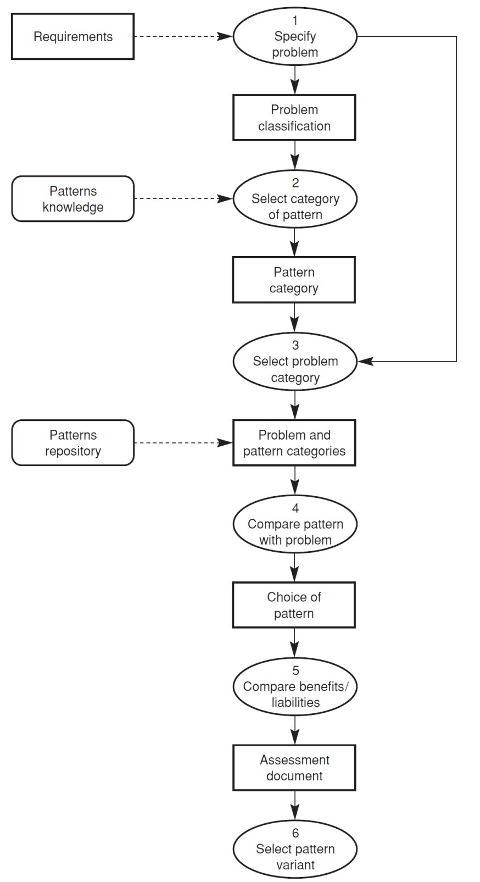
Designing with Patterns [4]

Slide 19

What is OOP? [5]
“The combination of data and function.”
“A way to model the real world.”
Some folks fall back on three magic words to explain the nature of OO: encapsulation, inheritance, and polymorphism.

Slide 20
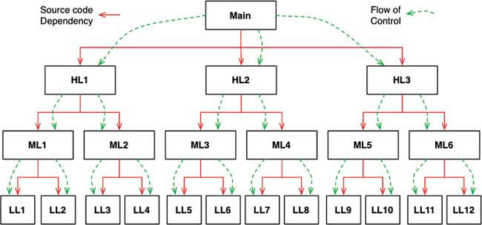
Dependency without Polymorphism
No control over the direction of all source code.
No deployed independently modules.

Slide 21
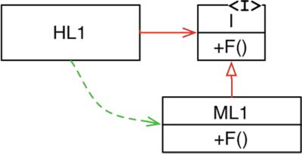

Dependency Inversion
The source code dependency (the inheritance relationship) between ML1 and the interface I points in the opposite direction compared to the flow of control.
Any source code dependency, no matter where it is, can be inverted. Any of those source code dependencies can be turned around by inserting an interface between them.
Components can be deployed separately and independently.

Slide 22
OOP & Design
OO is the ability, through the use of polymorphism, to gain absolute control over every source code dependency in the system.
It allows the architect to create a plug-in architecture, in which modules that contain high-level policies are independent of modules that contain low-level details.
The low-level details are relegated to plug-in modules that can be deployed and developed independently from the modules that contain high-level policies.

Slide 23
Review
Structured programming imposes discipline on direct transfer of control.
Object-oriented programming imposes discipline on indirect transfer of control.
Functional programming imposes discipline upon assignment.
Each of these three paradigms has taken something away from us. What we have learned over the last half-century is what not to do.
Software—the stuff of computer programs—is composed of sequence, selection, iteration, and indirection. Nothing more. Nothing less.

Slide 24

Thank You & See You Again

